Slide 1
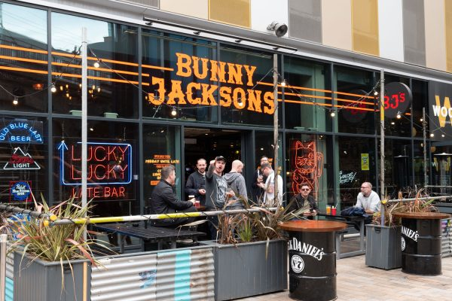

EMPLOYER – Bunny Jacksons
JOB ROLE – Bar and waiting team member
RATE OF PAY- NMW
WEEKLY HOURS – 30-45, will include evenings and weekends
CONTRACT – Full time Permanent
LOCATION – Manchester City Centre
M15 4RA
You must meet the legal requirements to work in the UK.
WHAT WE ARE LOOKING FOR
Previous experience in a similar role and environment.
A friendly, professional, and customer-focused attitude.
Strong communication and teamwork skills.
Ability to work flexible hours, including weekends and holidays.
A passion for hospitality and delivering exceptional service.
Bubbly personality

